Slide 1
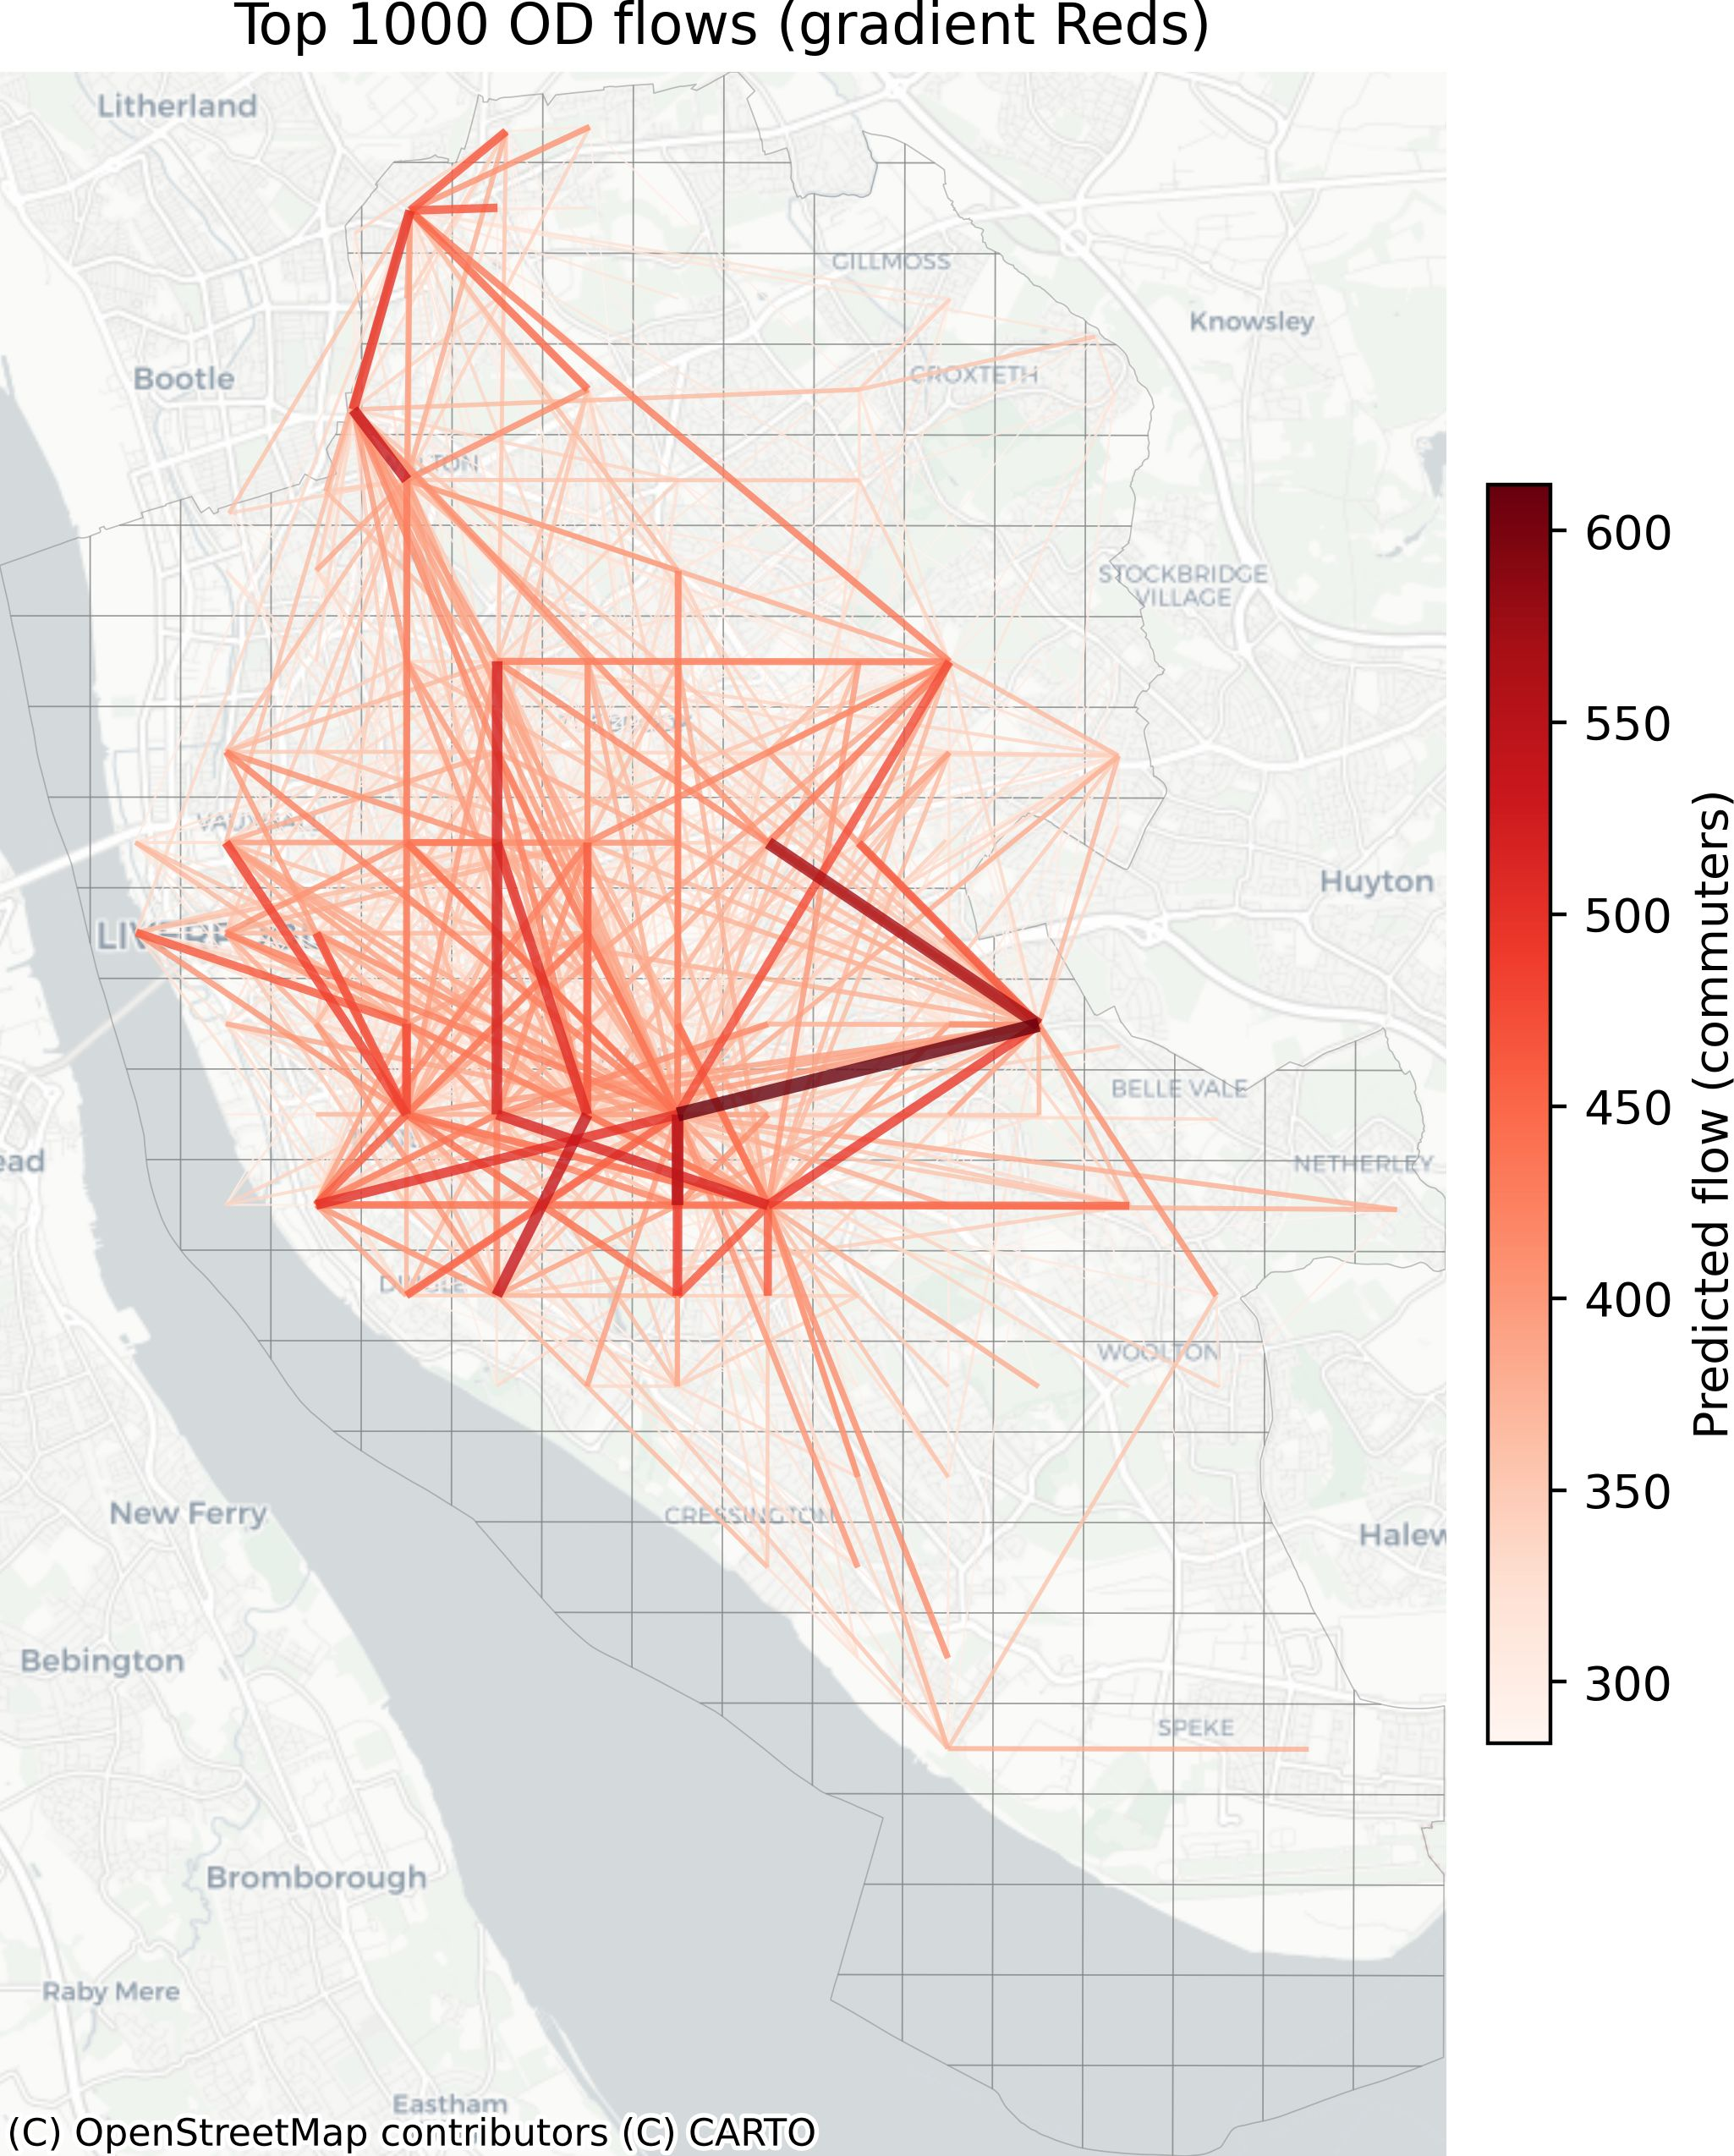
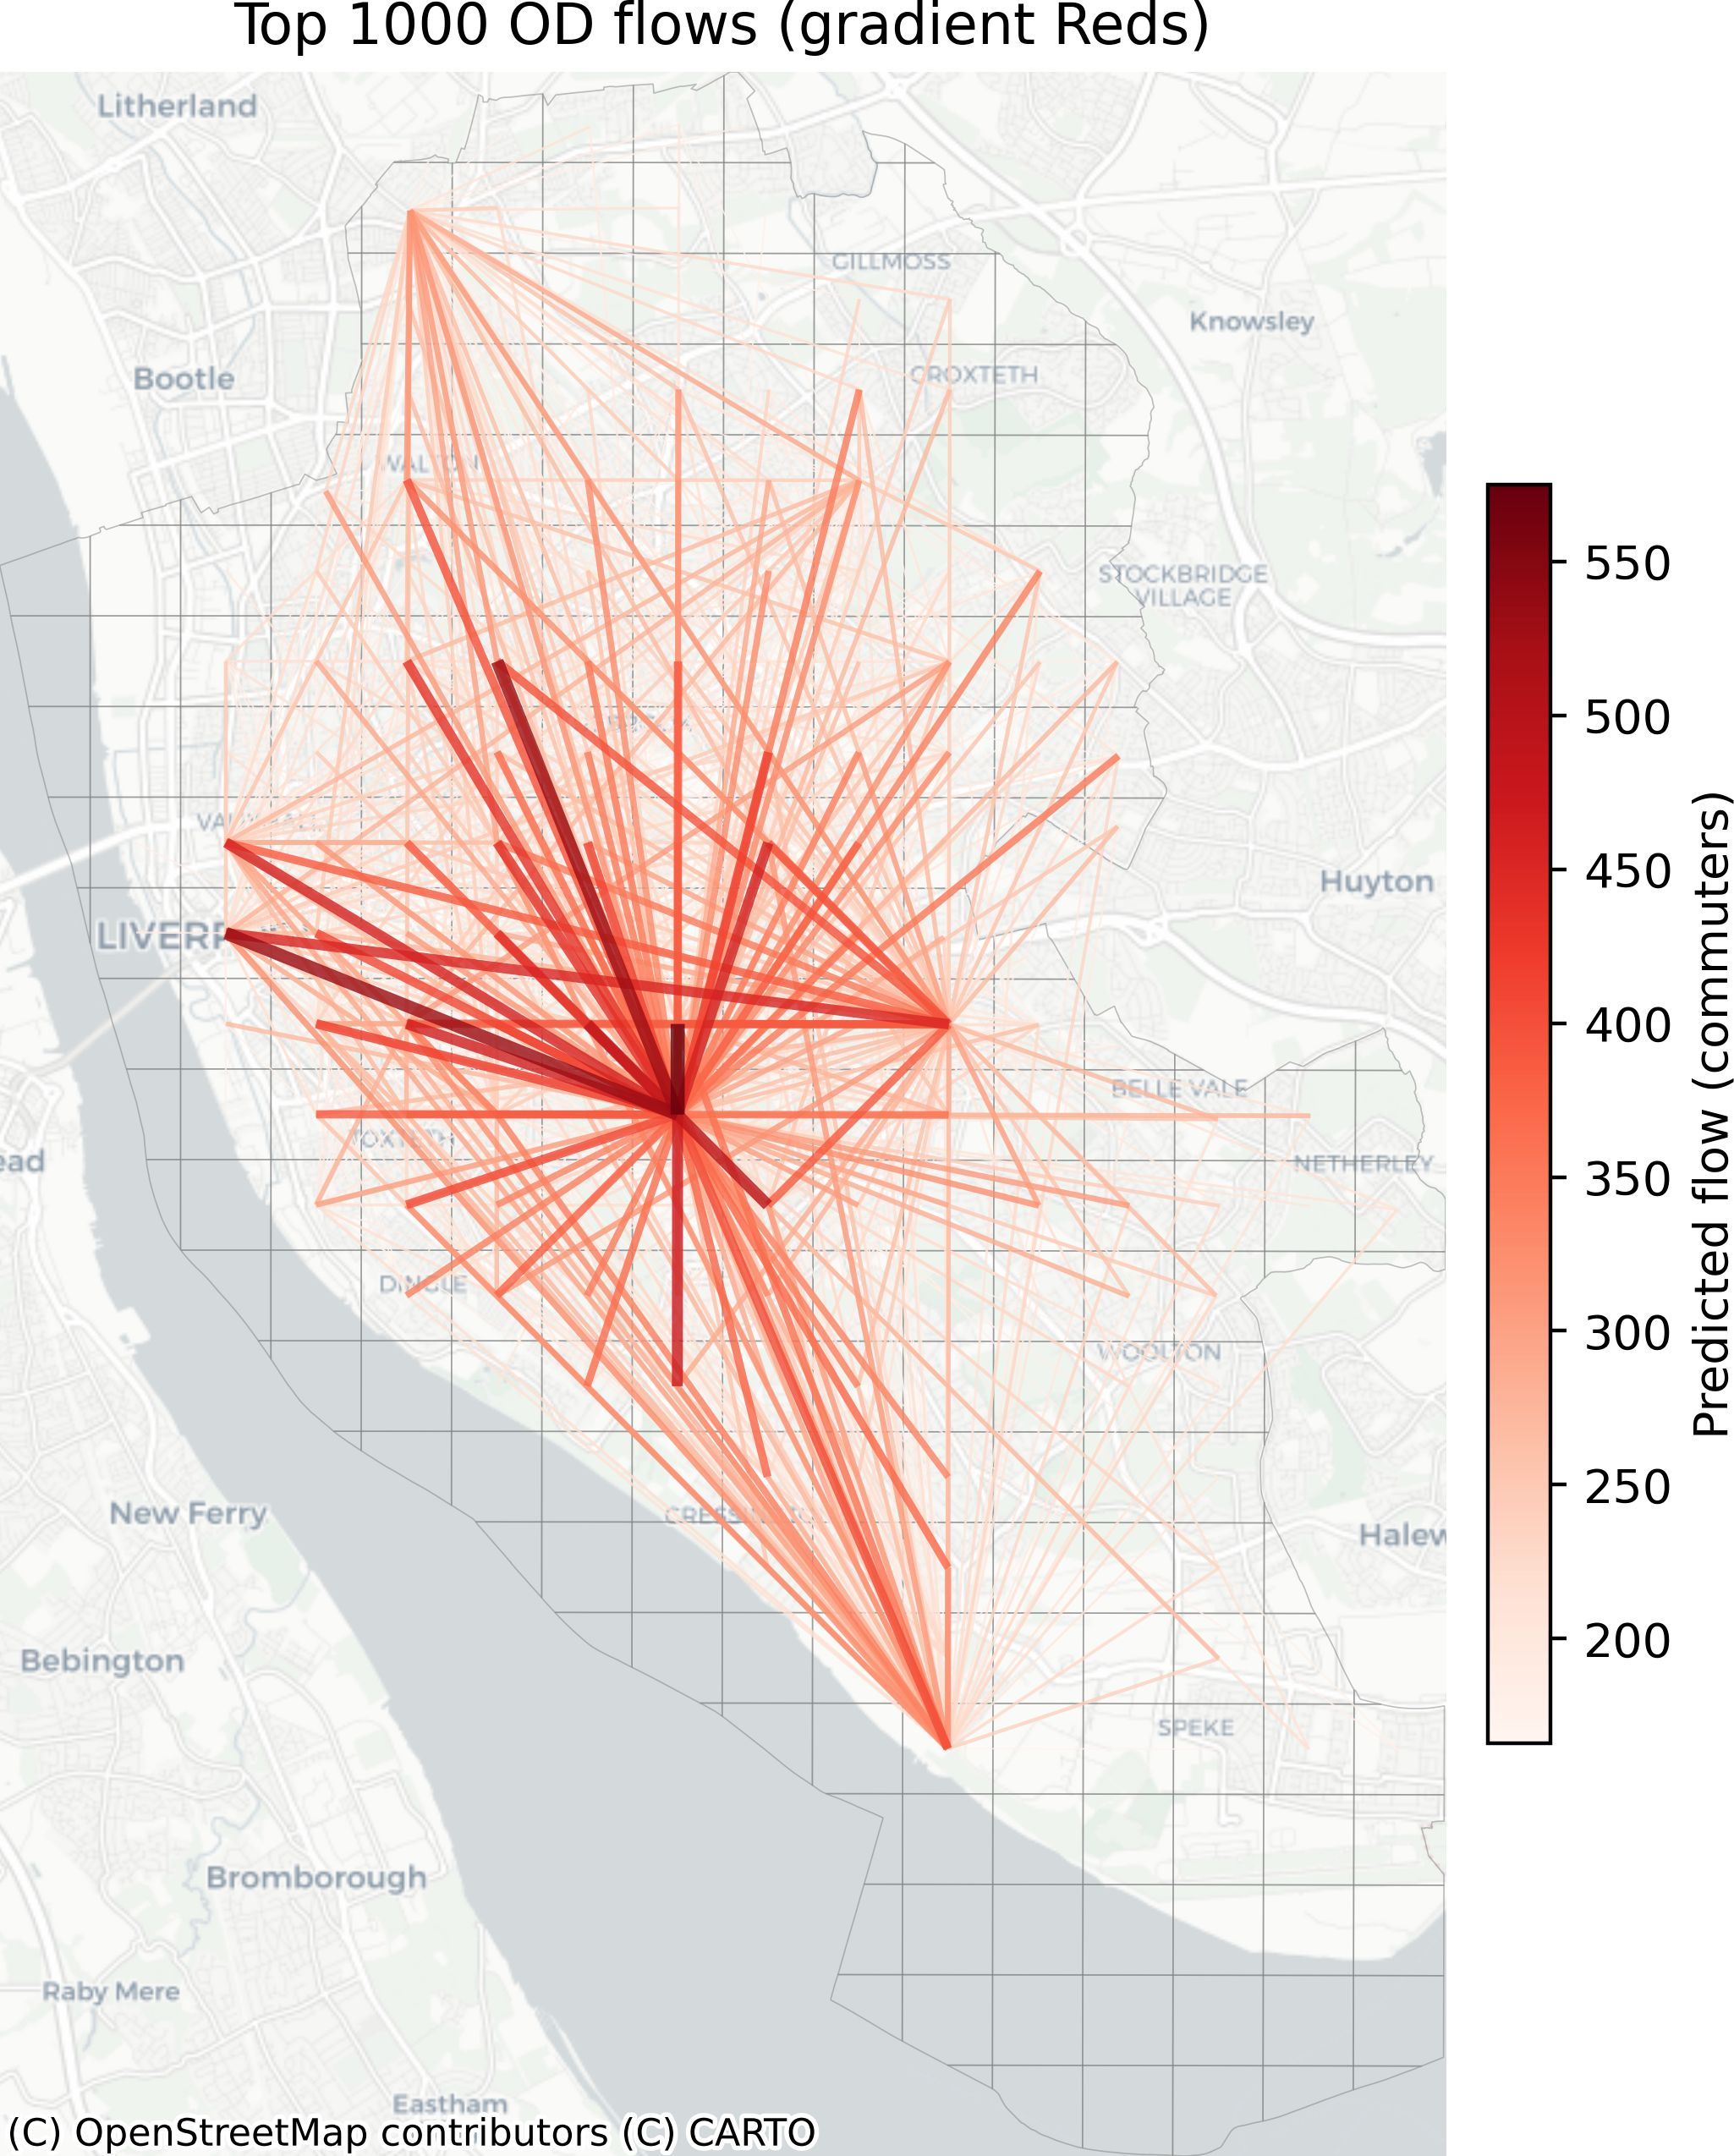
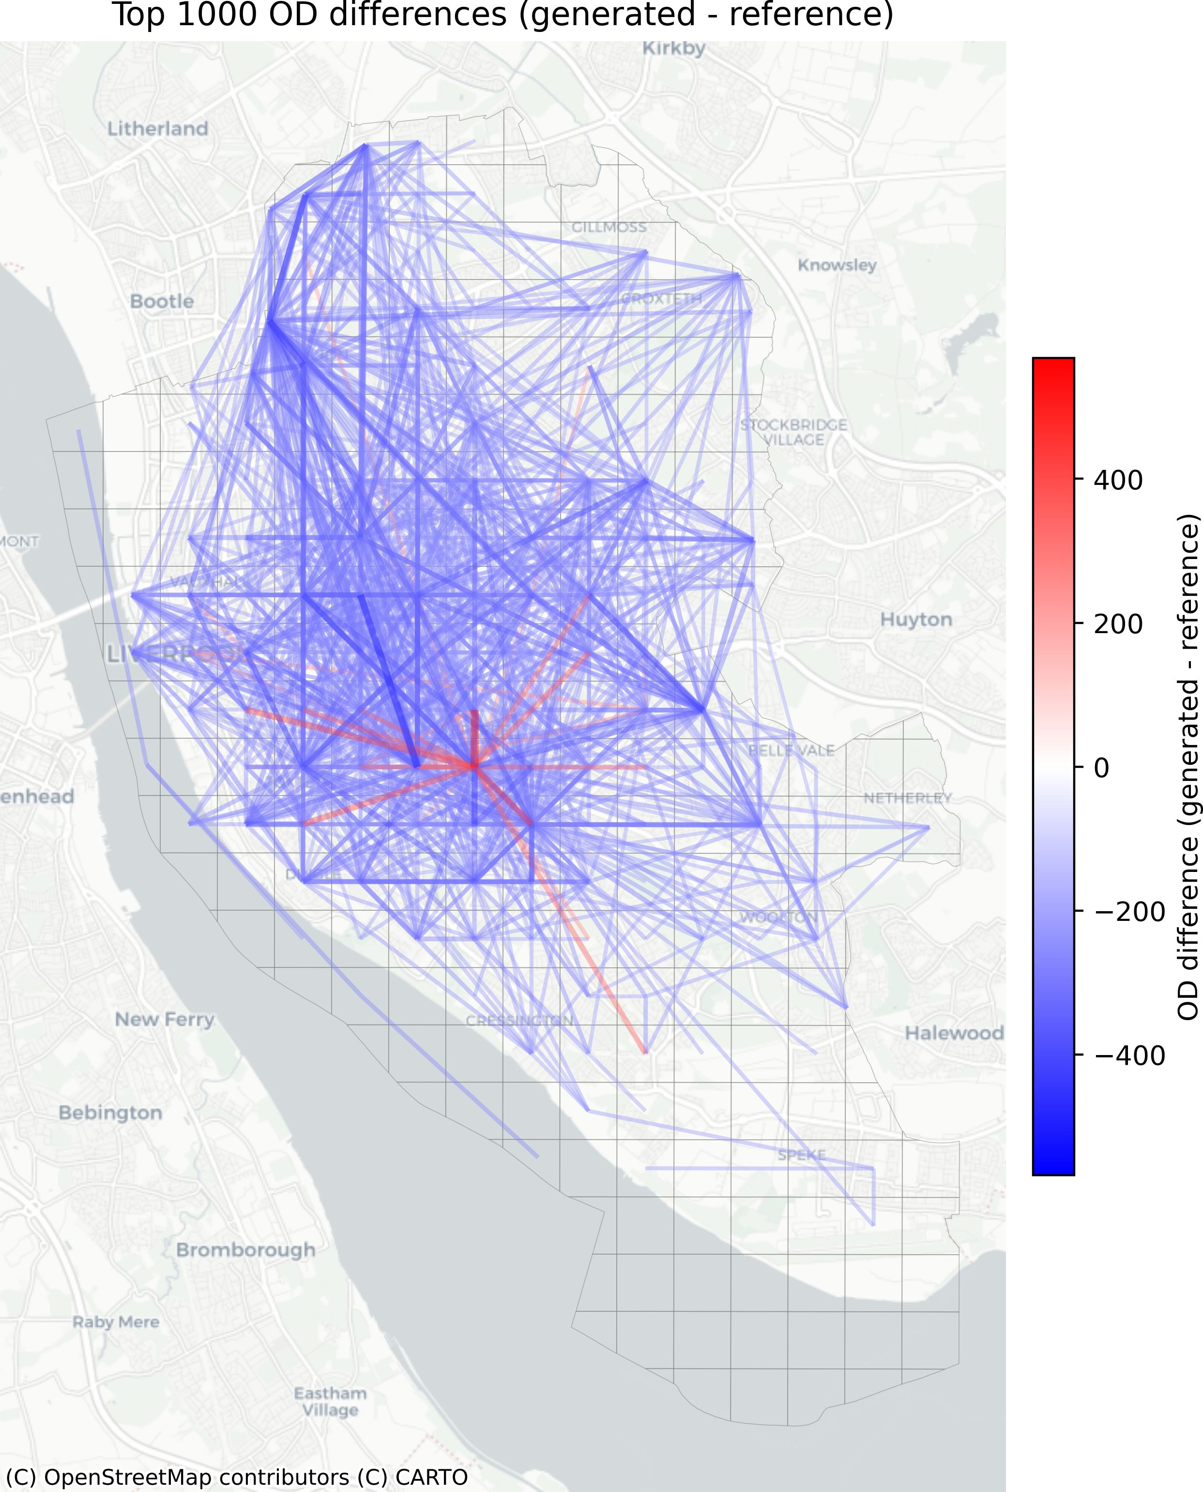
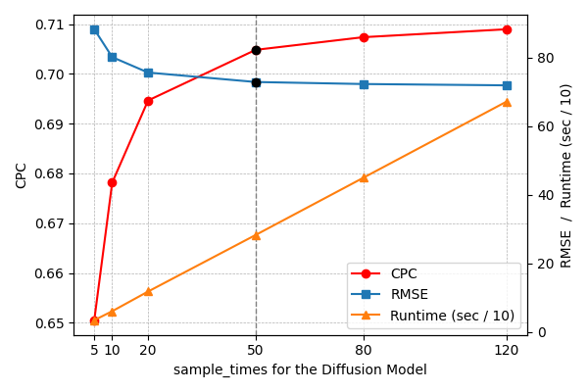
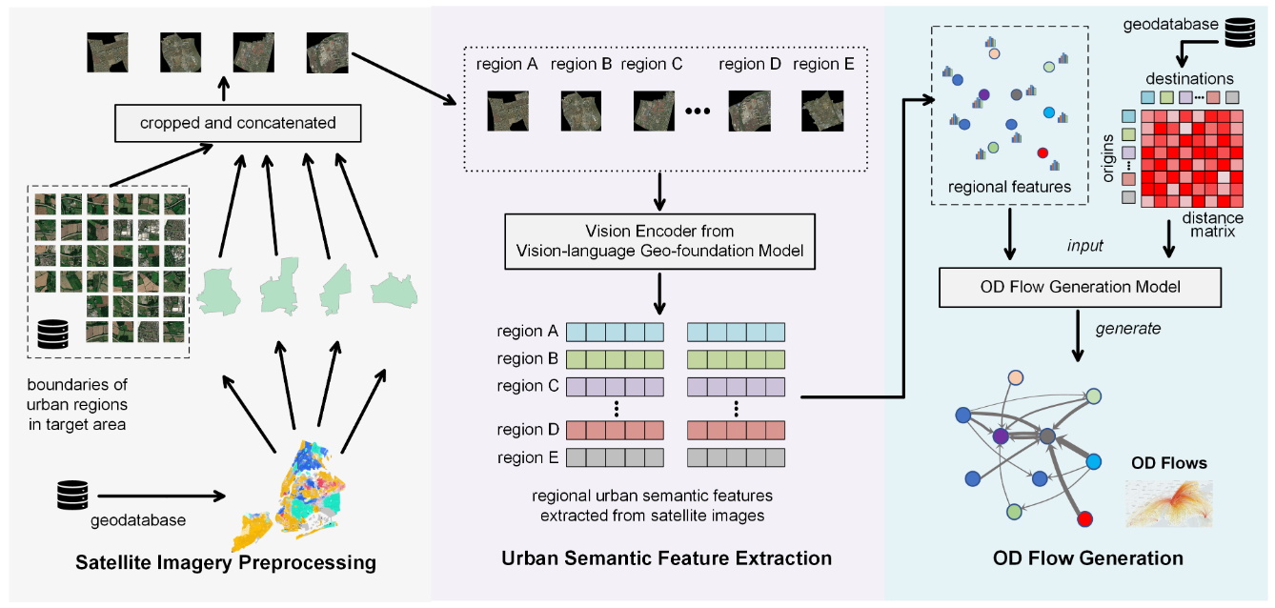
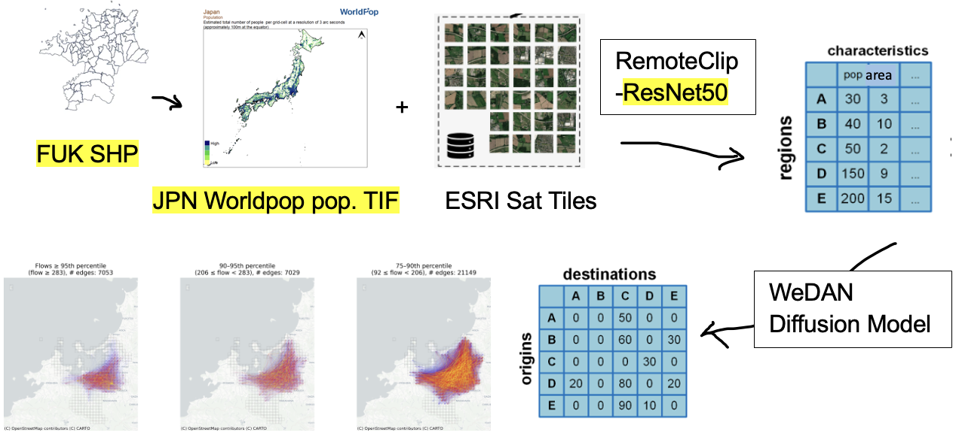
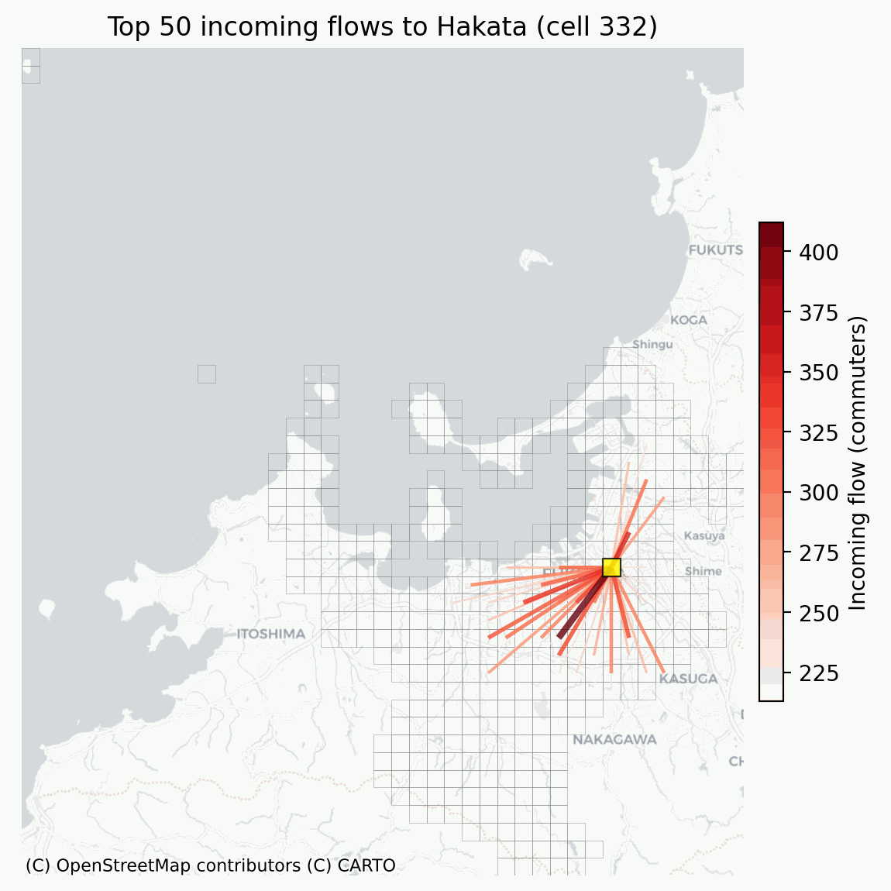
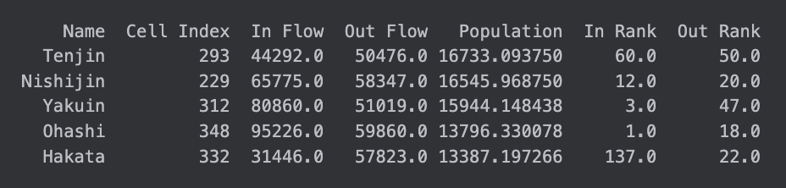
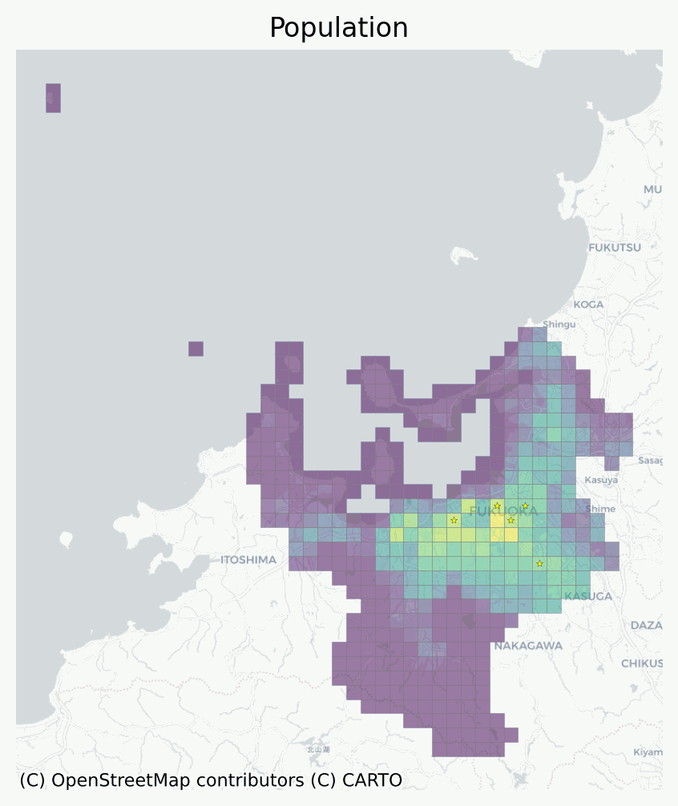
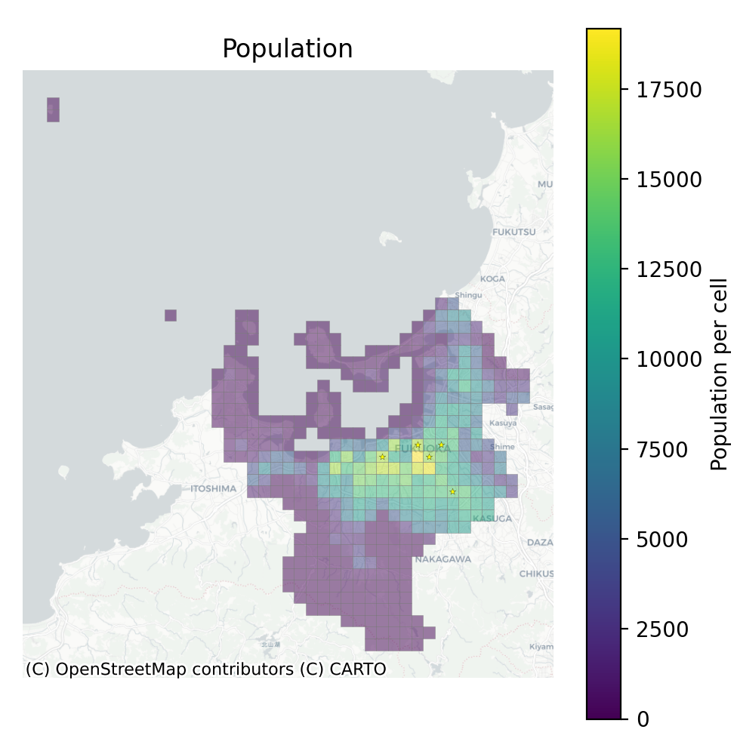
Diffusion-based Commuting Flow Generation for Fukuoka City: Adapting a Global OD Model for Sustainable Urban Mobility
David Cheung
UCL MSc AI for Sustainable Development
Original Paper Generate commuting OD matrices using cheap, widely available data instead of expensive surveys/location traces.
Method: Treat each city as a directed weighted graph; use WeDAN diffusion model to generate edge weights from node attributes (Population, area, distances).
Results: On 3k+ US areas, graph-based generative models outperform gravity/radiation and pairwise ML on RMSE, NRMSE and CPC, and generalise across diverse urban/rural regions.
Adaptation of the Model Architecture
Base: Reuse the released OD diffusion model architecture (same number of layers / heads)
Context-specific changes: Bypass the GlODGen ArcGIS service and instead use predownloaded local WorldPop 2025 TIFs. For Fukuoka:
build a custom 431-cell grid from Japanese sub-ward polygons and calibrate cell-level population and area to official Fukuoka city totals.
tune diffusion sampling hyperparameters (T=250, DDIM_T_sample=25, sample_times=50) via Liverpool study.
Model Performance (Liverpool + transfer logic)
For Liverpool, I ran 10 seeds for each sample_times ∈ {5,10,20,50,80} and rescale generated OD to match total flows. The best setting is sample_times=50: RMSE ≈ 72.9 ± 1.8, NRMSE ≈ 0.99 ± 0.02, CPC ≈ 0.705 ± 0.006. Increasing beyond 50 gives marginal CPC gains for much higher runtime. I interpret this as a statistical reproduction of the reference matrix, not bitwise equality.
For Fukuoka, without ground truth
- evaluate global structure:
Corr(pop, out_flow) = 0.895 and
Corr(pop, in_flow) = 0.852.
- commuting is strongly shaped by population, but not purely proportional, with multiple CBDs acting as both origins and destinations.
New Context (Fukuoka city, Japan)
Local challenge: Fukuoka faces growing commuter flows between key centres (Hakata, Tenjin, Ohashi) with congestion, emissions
Datasets Liverpool as baseline reproduction - GB_Liverpool shapefile (252 regions) and a GBR 2025 WorldPop TIF. Comparing result against the repo’s generation.npy OD matrix.
Fukuoka - a custom 431-cell grid, JPN 2025 WorldPop TIF, and calibration to Fukuoka’s official population (1,620,574) and area (343.39 km²). No ground-truth OD matrix is available, focus on structural plausibility.
Evaluation of the Performance: Major CBD cells all lie within the top 1/3 of inflow/outflow ranks, consistent with Fukuoka’s known polycentric core. Quantile-banded flow networks show strong corridors from southern and western residential cells into central CBDs.
Goal: Use the OD generator to simulate realistic commuting flows over a grid of Fukuoka, supporting transport planning and low-carbon mobility policies, targeting SDG 11 (sustainable mobility) and SDG 10 (reduced inequalities)
Discussion and Critical Reflections on SDGs
SDG 11 (Sustainable Cities): Help identify high-demand corridors where extra rail capacity or bus lanes and peripheral zones with weak connectivity to job centres.
SDG 10 (Reduced Inequalities): Cells with high outflow but weak local inflow suggest job-housing imbalances and potential transport poverty.
City | Regions | Area (km²) | Population | OD Matrix Shape | Ground truth OD?
Liverpool | 252 | 111.8 | 508,961 | 252 × 252 | Yes (from original repository)
Fukuoka City | 431 | 343.39 | 1,620,574 | 431 × 431 | No (generated only)
Email: ka.cheung.25@ucl.ac.uk
Github: https://github.com/kccheung/generate-od-pubtools

